Slide 1


Enhancing Real Estate Investment Decisions with Predictive Modeling
Unlock superior investment opportunities. Predictive modeling transforms real estate analysis. Gain a competitive edge in dynamic markets.
by JAYESHWAR .R

Slide 2




Objective: Forecast Australian Housing Prices
Accurate Price Prediction
Market Expansion
Focus on Australian housing markets for strategic entry.
Develop models to forecast housing prices precisely.
Investment Optimization
Identify profitable opportunities with data-driven insights.

Slide 3
Dataset Overview & Cleaning
Initial Dataset
Data Cleaning Process
1460 entries
Missing value treatment
81 features (train + test)
Dropped high-missing features
Comprehensive real estate data
Ensured data integrity

Slide 4








Exploratory Data Analysis
SalePrice Skewness
Feature Correlations
Identified non-normal distribution of prices.
Analyzed relationships between variables.
Outlier Removal
Distribution Insights
Eliminated extreme values for accuracy.
Revealed underlying data patterns.

Slide 5





Feature Engineering & Model Selection
TotalSF Calculation
Combined square footage features.
TotalBath Creation
Aggregated bathroom counts.
HouseAge Derivation
Calculated property age.
Encoding Methods
Applied categorical variable transformations.

Slide 6
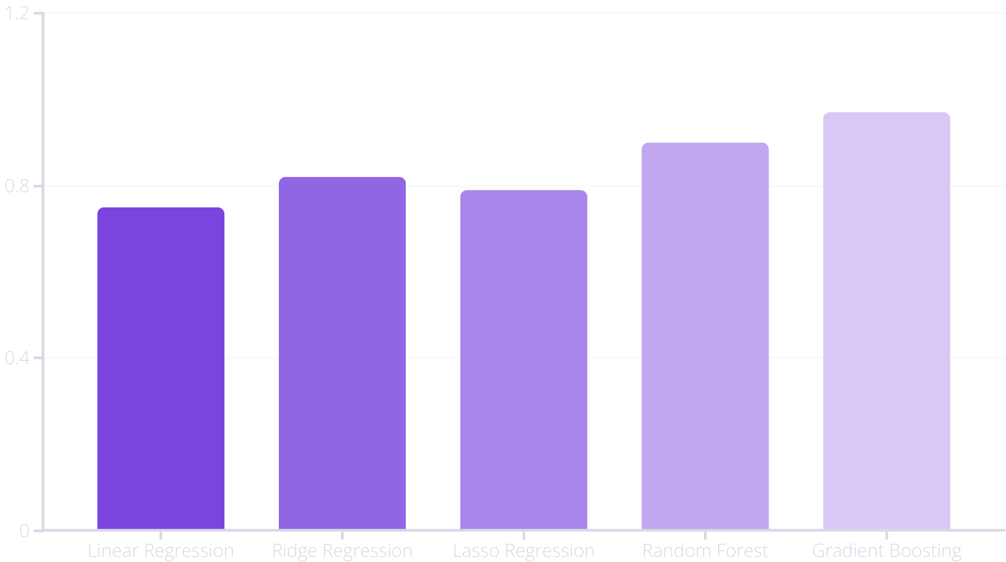
Model Comparison & Evaluation
Gradient Boosting emerged as the top performer. Its 0.97 R² score signifies exceptional accuracy. This model provides robust predictive capabilities.

Slide 7








Key Feature Importance
OverallQual
Dominant factor in price prediction.
GrLivArea
Above grade living area impacts value.
GarageCars
Garage capacity is highly influential.
TotalSF
Total square footage is a critical metric.
Understanding these features optimizes investment strategies. Focus on properties excelling in these key areas.

Slide 8
Business Impact & Recommendations
Identifies undervalued properties for strategic investment.
Focus on properties with high OverallQual and ample living space.
Consider new constructions for better price predictability.
Utilize ML tools for continuous market analysis.
These insights enable superior returns. Our models support data-driven decisions. Future markets will benefit from this approach.

